Slide 1

Hallucination Across
various Retrieval
Augmented Generation
(RAG) Strategies
DISSERTATION INTRODUCTION
A comparative study on how different RAG architecture influence LLM hallucinations.
ANKIT MAHTO - 13454

Slide 2

INTRODUCTION
  In modern times, advancement in Artificial intelligence has given birth to large language models have been revolutionary across all aspects of human life.
  Large language models are being adopted in various fields such as medical, banking, retail, corporate, academia...
  However, these LLMs have some underlying issues, most notable being LLM hallucinations.
  This is where RAG comes in, in recent years, RAG has proven to be a great method for mitigating LLM hallucinations along with other problems.
  This research paper will compare and contrast different architectures of Retrieval-Augmentation Generation to find correseponding hallucination rates in large language models (LLMs).
  This research paper will be descriptive/exploratory in nature.
2

Slide 3
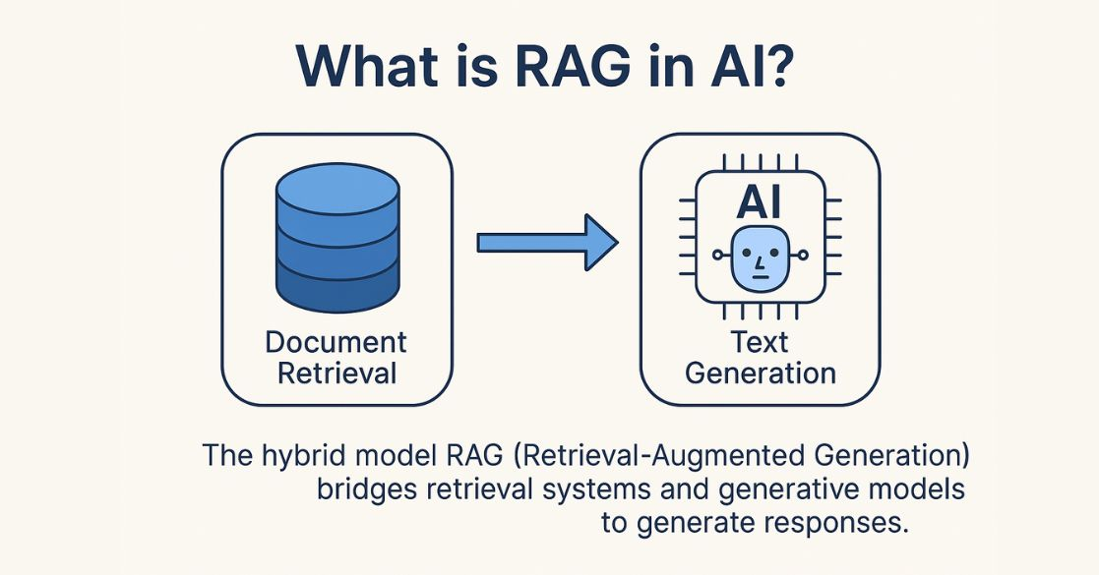
BACKGROUND
What is retrieval-augmentation generation (RAG)
1
RAG is a AI architecture by which a LLM model can access private data.
Why do we need RAG?
2
  A LLM is pretrained models that predicts the ouput based on the parametric knowledge (pretrained knowledge).
  A LLM by default doesn’t have access to outside knowledge
  This leads to several issues, which we will see further

Slide 4
Problems RAG solves with plain LLM
Common issues encoutered when dealing with vanilla LLM
1
2
3
4
Knowledge cut-off
Lacking private data
Expensive training
Hallucinations
LLMs don’t have the knowledge of newere data which they werent trained on. so they can’t answer questions related to recent events.
LLMs dont have access of the personal data. Therefore, they can’t answer questions related to personal data
Training LLMs with newer data takes time and cost. RAG solves this by feeding newer knowledge to LLMs directly
When LLMs don’t have the required data, they hallucinate and make up rnadom information and reply confidently. This is called hallucination effect
These are some of the core problems that RAG solves effectively. But for the sake of this study we will focus on hallucination part.
3

Slide 5
Purpose of this study
Why we are doing this study
01
Find hallucination rates accross different RAGs
02
Compare and contrast accross different sub fields
03
Literature gap
7

Slide 6
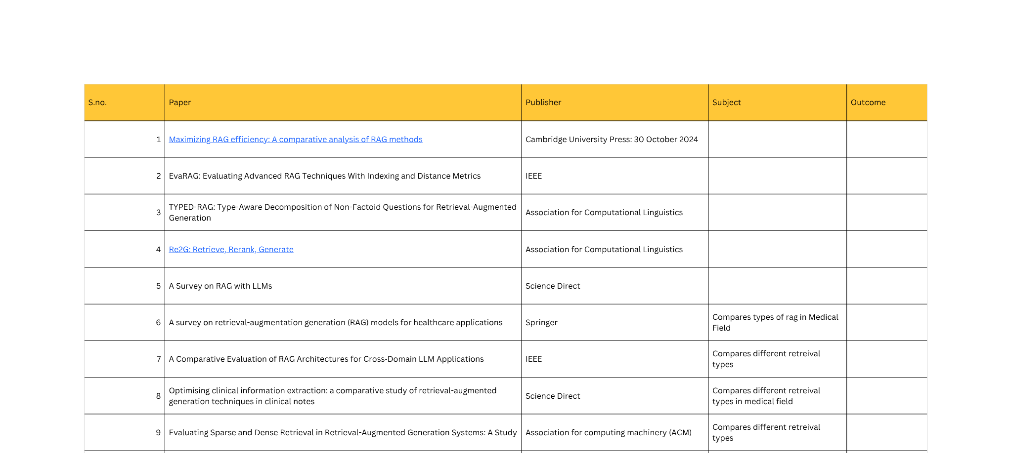
Literature review
8

Slide 7
RAG Taxonomy
Retrieval decides what the model even gets to see
1
2
3
4
Query
Retrieve
Augment
Generate
→
→
→
A question comes in, needing information beyond the model's parameters.
An index (vectors, keywords, or a graph) pulls candidate passages from a corpus.
Retrieved passages are inserted into the model's context window.
The LLM writes an answer — ideally grounded in what it was handed.
3

Slide 8
Basic architecture of RAG
RAG Components
Indexing
Retrieval
NOTE: for the sake of this study, we will only only consider two major components of RAG as these are where most changes and comparisons would be made. Other parts such as Augmentation and generation will mostly remain constant

Slide 9
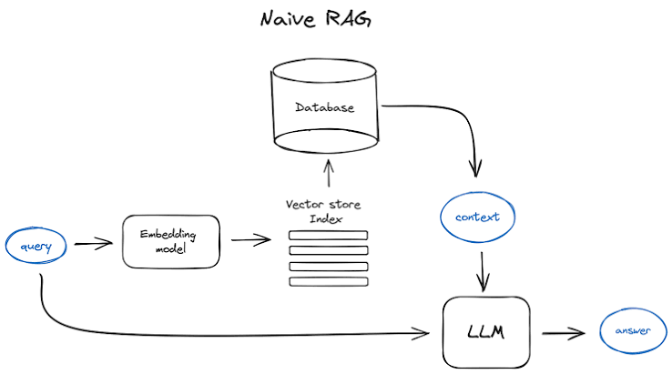
Naive RAG Architecture
3

Slide 10
Other RAG Architectures
Naive RAG
Advanced RAG
Modular RAG
Self-RAG
Graph RAG
Corrective RAG
Agentic RAG
Adaptive RAG
10

Slide 11
Methodology
Proposed mehtodology for this study
1
2
3
Choose dataset
Choose evaluation metric/framework
Choose a RAG strategy
→
→
6
5
→
4
Apply hallucination Evals/RAG Evals
on generated outcome
→
Retrieve and push to a LLM
→
Provide data and index
→

Slide 12
Datasets
Datasets that can be used for retrieval
Medical
Law
Corporate
Science
  MedRAG
  Mirage
  pubMedQA
  Legalbench-RAG
  SC Judgements
  Legal RAG bench
  EnterpriceRAG bench
  RAG multi corpus
  Hugging face datasets
  SciQ
  RAGCare-QA
  Open RAG bench
7

Slide 13
LLM Models
Top Open source models
KIMI K3
GLM 5.2
Gemma 4 26B A4B
Deepseek V4 Pro
Parameters: 2.8 Trillion
Context length: 1 million token
Disk size: 1.56 TB
Parameters: 753 Billion
Context length: 1 million token
Disk size: 1.51 TB
Parameters: 26 Billion
Context length: 256K token
Disk size: 48 GB
Parameters: 1.6 Trillion
Context length: 1 million token
Disk size: 893 GB
Qwen 3.8-Max
Llama 4 Maverick
Min-Max M3
Parameters: 2.4 Trillion
Context length: 1 million token
Disk size: 1.2 TB
Parameters: 400 Billion
Context length: 1 million token
Disk size: 800 GB
Parameters: 428 Billion
Context length: 1 million token
Disk size: 128 GB
10

Slide 14
Things to consider
Changes can be applied to different components
Core Architecture
Control flow/behavior
Retrieval mechanism
Knowledge structure
Naive RAG
Sparse (BM25)
Flat / chunked
Self-RAG
Advanced RAG
Dense (embeddings)
Hierarchical (RAPTOR)
Corrective RAG
Modular RAG
Hybrid (fused)
Graph RAG
FLARE
Agentic RAG
Adaptive RAG
4

Slide 15
Things to consider
Changes can be applied to different components
RAG EVALS
HALLUCINATION EVALS
Score the whole pipeline
Score the output on its own terms
TruthfulQA — common-misconception factuality
Context precision — are retrieved chunks relevant?
HaluEval — paired correct / hallucinated samples
Context recall — was everything needed retrieved?
SelfCheckGPT — consistency across samples
Faithfulness — does the answer match retrieved context?
RAGTruth — word-level hallucination spans in RAG
Answer relevance — does it address the query?
4

Slide 16
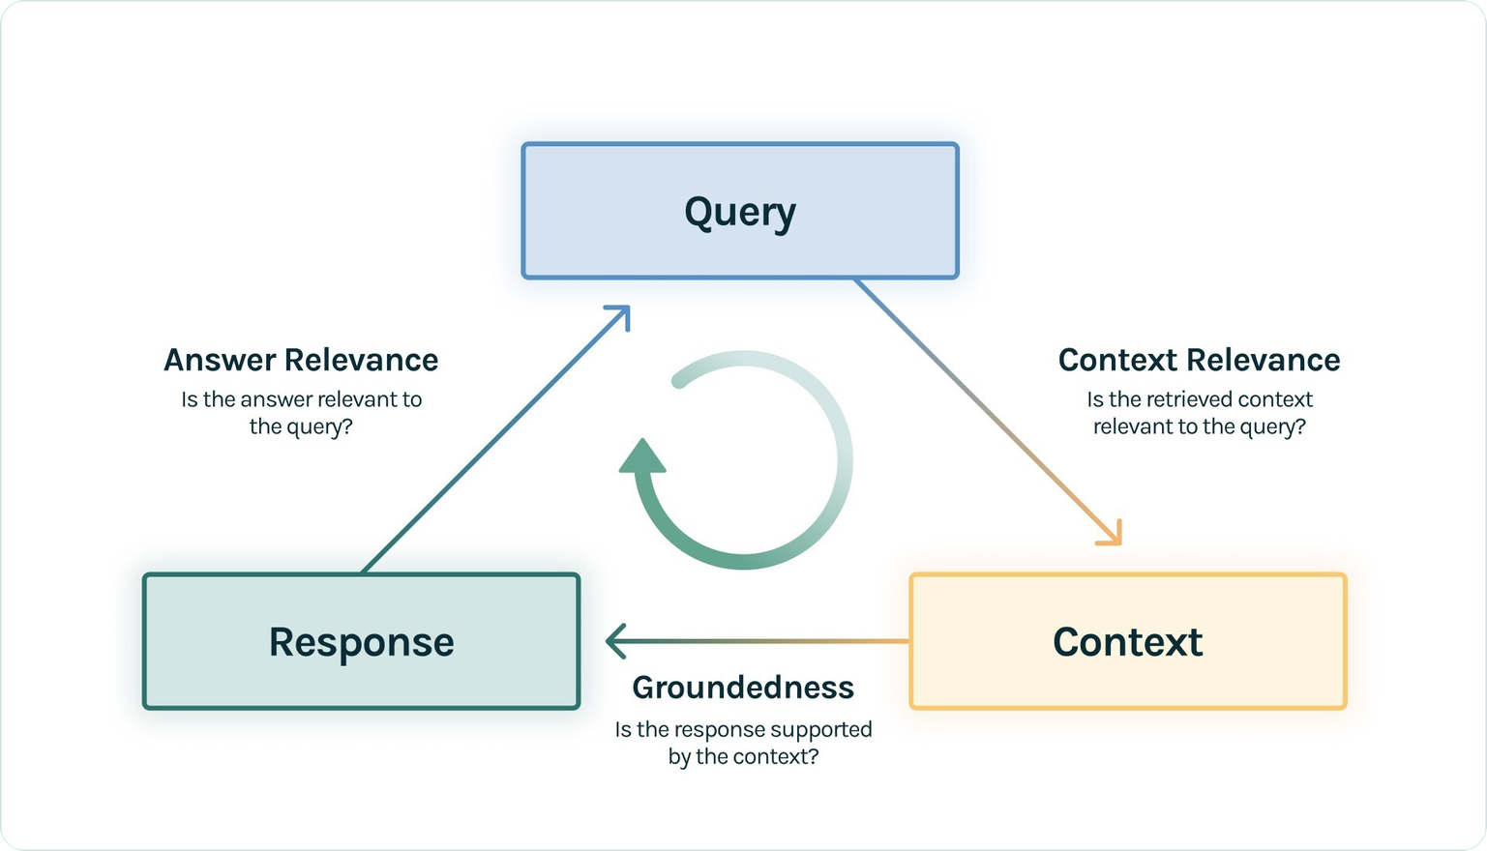
Evals
Evaluation Metric: RAG Triad
NOTE: Hallucination on in itself cannot be measured by just single metric, thats why we will be looking at multiple factors to judge the outcome. The best way to judge this is by using RAG traid. It measures the out put based on 3 metrics: Context Relevance, Answer Relevance and groundedness. It does 2 test before output generation and 2 after the generation.

Slide 17
Eval Metrics
Retrieval
Generation
1
2
3
4
Context recall
Context relavance
answer relevance
Faithfulness
Determines if all necessary pieces of information were successfully retrieved by the system
→
Assesses whether the retrieved chunks contain relevant information with minimal noise.
→
Measures how directly the final answer addresses the user's initial query.
→
Checks if the generated response is strictly grounded in the retrieved context to reduce hallucinations.
10

Slide 18
Evals
Potential Eval frameworks
RAGAS
DeepEval
LangSmith

Slide 19
Thank you

